Slide 1

Rockbuster
Stealth
Analysis of Film Revenue and Customer Location

Slide 2

Objective
Rockbuster Stealth is launching a movie rental platform and is interested in knowing:
Which movies contributed the most/least to revenue gain?
What was the average rental duration for all videos?
Which countries are Rockbuster customers based in?
Where are customers with a high lifetime value based?
Do sales figures vary between geographic regions?

Slide 3
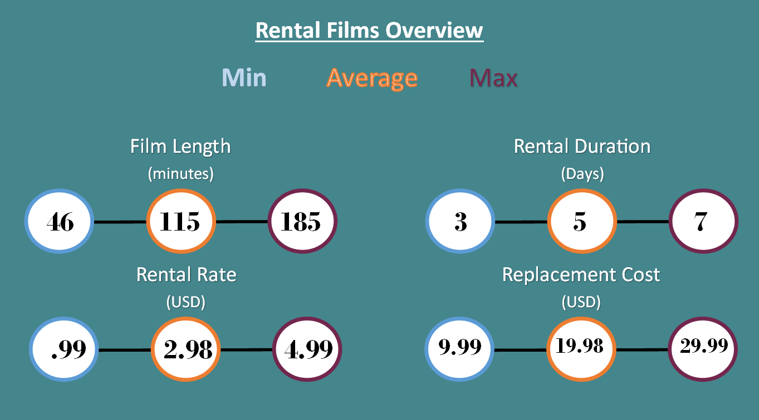

Slide 4


Best and Worst Movies
Least Popular - $5.90
Most Popular - $215.80
Duffel Apocalypse
Oklahoma Jumanji
Texas Watch

Slide 5

Top 10 Customers
First | Last | Country | Total Spent
E. | Hunt | Runion | $ 211.55
K. | Seal | United States | $ 208.58
M. | Snyder | Brazil | $ 194.61
R. | Kennedy | Netherlands | $ 191.62
C. | Shaw | Belarus | $ 189.60
T. | Collazo | Iran | $ 183.63
A. | Bradley | United States | $ 167.67
C. | Irby | Canada | $ 167.62
M. | Dean | Philippines | $ 166.61
M. | Way | India | $ 162.67

Slide 6
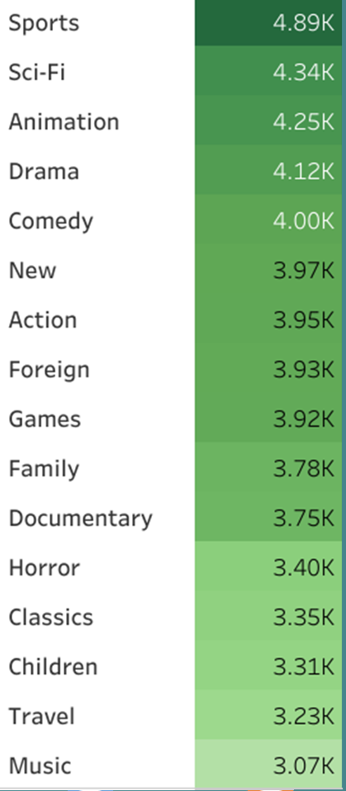

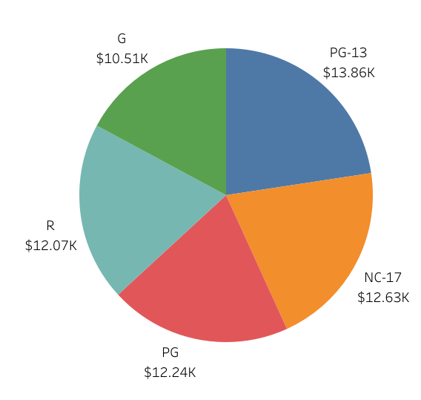

Revenue
By Rating and Genre

Slide 7
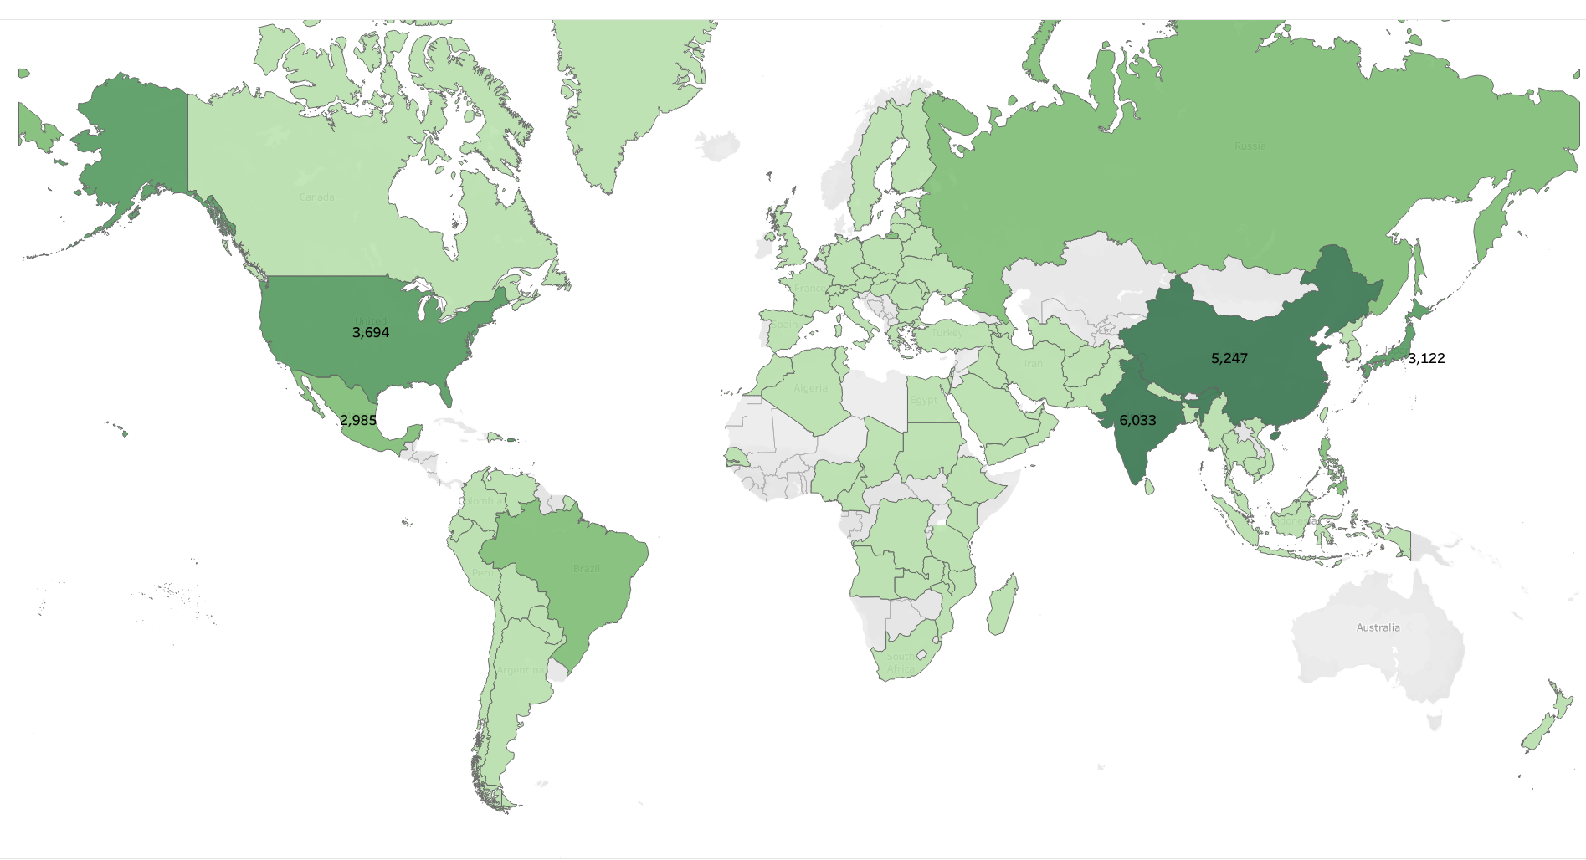
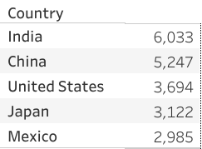
Top 5 Countries – Revenue

Slide 8
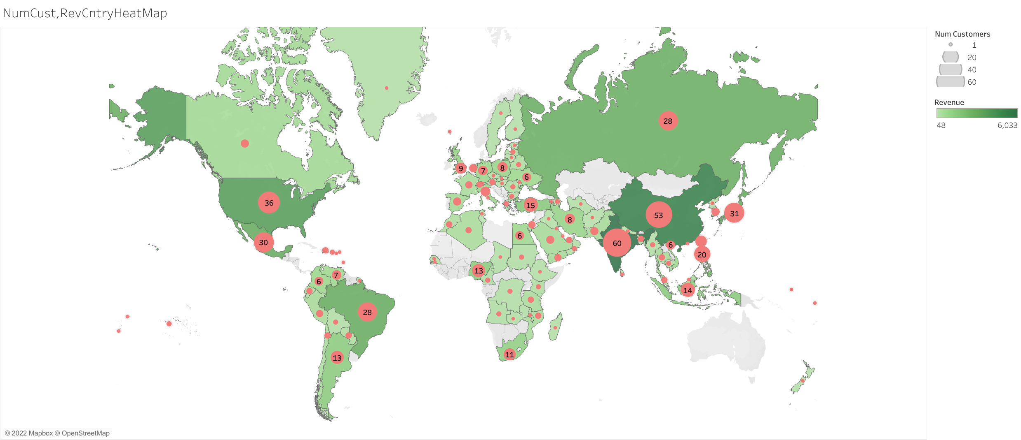
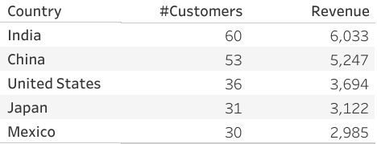
Rev Heat Map + Customers
Top 5 Countries - Customers

Slide 9
Recommendations
Location:
The largest markets to rollout first are India, China, United States, Japan, and Mexico
Genre:
Begin with most popular genres of movies which are Sports, Sci-Fi, Animation, Drama, and Comedy
Licensing:
Acquire licensing for the most popular movies first

Slide 10
Thank You
Tableau Link
https://public.tableau.com/views/3_10FinalVisuals/RevFilm?:language=en-US&publish=yes&:display_count=n&:origin=viz_share_link

